Slide 1
School of Instruction
PRESIDENTIAL GENERAL ELECTION
NOVEMBER 3, 2020

Slide 2
School of Instruction
PURPOSE
Countywide
46 ballot types
66 precincts
    9 – 4-Day Voter Assistance Centers
    4 – 1-Day Voter Assistance Centers (Popups)
83,670 voters participating

Slide 3
The School of Instruction is an overview of manual contents.
Training Goals
Learn how to navigate manual.
Know where to find information when needed.
The more time you spend studying the manual before you arrive at the polls, the more prepared you will be.

Slide 4
School of Instruction
overview
Contact Information
Preparing to Serve
Voter Rights
Voting
COVID Protection and Guidelines
Election Worker Conduct
Emergency Response
Conduct at the Polls

Slide 5
School of Instruction
overview
Election Worker Basics
Voting Equipment and Security
Voter Assistance Center Layout
Voting Area Set-up Procedures
Early Voting Opening Procedures
Early Voting Night Closing Procedures
Election Morning Opening Procedures
Election Night Closing Procedures

Slide 6
School of Instruction
Contact information
Election Workers
  Election Worker Hotline – verify or update voter status.
  Office Main Line – technical, process, and general issues.
  Emergency Hotline – anytime 9-1-1 is called.
  Lucinda Jackson – if main line is busy or cannot resolve issue.
  Law Enforcement –emergency and non-emergency support
Voters
  Office Main Line

Slide 7
Section 2
Preparing to Serve

Slide 8
School of Instruction
PREPARING TO SERVE
Election Dates and Hours
  4-Day: October 31-November 3
  1-Day: November 3
Training - Be Prepared
Oath of Office
  You are an extension of the Office of Elections
Breaks and Meals
  Take care of yourself.

Slide 9
School of Instruction
PREPARING TO SERVE
DO | DO NOT
Arrive 60 minutes before the polls open Sign in so that we can pay you Bring food and water Take breaks Dress in comfortable business casual attire Bring a sweater or jacket Treat voters, co-workers, and visitors professionally and with respect Follow procedures for opening, closing, and election conduct Make sure the polls are tidy | Arrive late Eat or drink at voter stations Take a break when there’s a long line of voters Wear clothing that promotes parties, candidates, or political issues Forget to bring layers Use your cell phone for personal business at voter stations Bring children with you Leave the polls a mess

Slide 10
Section 3
Voter Rights

Slide 11
School of Instruction
Voter rights
All voters have the right to:
  Cast a ballot.
  Replace a spoiled ballot.
  Report fraud or illegal activities.
  Receive assistance.
  Access voting devices.
  Vote free of intimidation.

Slide 12
School of Instruction
VOTER ACCESSIBILITY
All voter assistance centers have been surveyed for accessibility.
  All voter assistance center teams will receive an ADA Guide with specific mitigation measures necessary for that location.
  Carefully set-up all mitigation measures identified.
  If you are missing required mitigation measures, contact the Office of Elections.

Slide 13
“
Curbside voting enables voters to have a voting experience outside the voting area when a polling place is not accessible.
”
Curbside Voting
  Precinct Voters
  Provisional Voters
Disability Sensitivity at the Polls
CURBSIDE VOTING

Slide 14
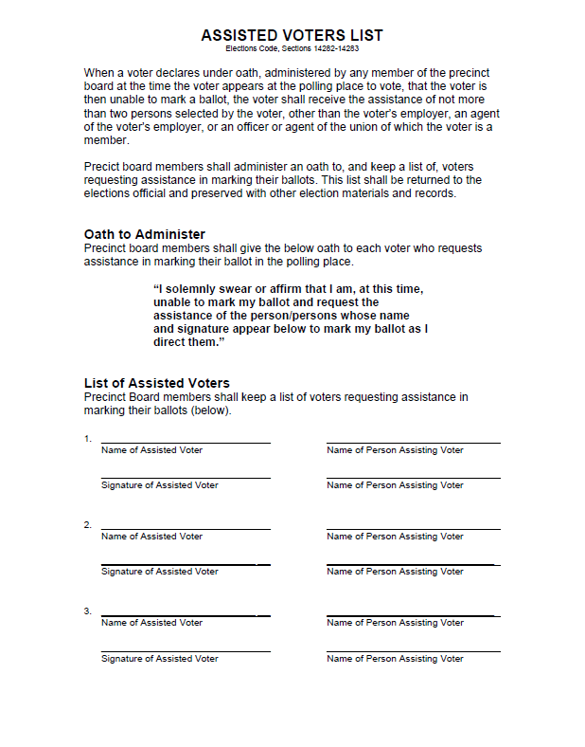
School of Instruction
Assisting a voter
Voters may have up to two (2) assistants.
Assistant cannot be:
  Employer.
  Agent of employer.
  Officer/agent of voter’s union.

Slide 15
Section 4
Voting

Slide 16
School of Instruction
Voting
Ballots
  Two-Sheet Ballot
  Handling
  Secrecy
  Spoiling
Types of Ballots
  Precinct Ballots
  Stock
  ER Provisional Ballots
  Spanish and Hmong Facsimile Ballots
Running out of Ballots

Slide 17
School of Instruction
Voting
Types of Voters
  Precinct Voters
  Vote by Mail Surrender Voters
  Vote by Mail Return Voters
  Provisional Voters
  HAVA ID Voters and Acceptable ID
  Inactive Voters
  Name Change Voters
  Challenged Voters
REVIEW THE MANUAL CAREFULLY. BE READY TO PROCESS EACH TYPE OF VOTER.

Slide 18
School of Instruction
Voting
Precinct Voters
  All active registered voters will receive a vote by mail ballot for this election.
  Voters must have a ballot to surrender to vote a precinct ballot.
  If a voter forgets to bring a ballot to surrender:
    Contact the election worker hotline to verify if the voter has voted.
    If the voter has not voted, a precinct ballot can be issued.
REVIEW THE MANUAL CAREFULLY. BE READY TO PROCESS PRECINCT VOTERS.

Slide 19
School of Instruction
precinct voters
May:
  Vote a pre-printed precinct ballot.
  Vote a precinct ballot on the Touch Writer.
Precinct Ballots may be:
  Inserted into the Scan.
  Inserted into the side compartment of the ballot box.
PRECINCT BALLOTS MUST REMAIN IN A SECRECY SLEEVE EXCEPT WHILE BEING VOTED

Slide 20
School of Instruction
precinct VOTERS
The following ARE NOT precinct voters.
  Voters that provide an address that does not match Main Roster or Poll Pad.
  Voters not on the Main Roster or Poll Pad.
  Voters from other precincts.
  Voters that registered after October 19.
  Voters not registered to vote.

Slide 21
School of Instruction
ADDRESS CHANGES
Precinct Voter
  Registered voter.
  Voter provides matching address.
  New address is in the same precinct.
Processing Address Change Voter
  Issue regular ballot.
  Voter must complete address change form.
IF THE VOTER DOES NOT MEET THIS CRITERIA, ISSUE A PROVISIOAL BALLOT

Slide 22
School of Instruction
Ballot surrender voters
Voters may surrender (exchange) their ballot for a precinct ballot.
Voters must:
  Appear in person at their assigned voter assistance center.
  Surrender the vote by mail ballot issued by the Office of Elections.
REVIEW THE MANUAL CAREFULLY. BE READY TO PROCESS BALLOT SURRENDER VOTERS.

Slide 23
School of Instruction
Ballot return voters
Ballot must be in a return envelope.
Envelope must be:
  Completed.
  Signed.
  Sealed.
Anyone can turn in a ballot for someone else.
Vote by mail ballots from anywhere in California can be turned in at your voter assistance center.
VBM BALLOTS WILL NOT GO THROUGH THE SCAN

Slide 24
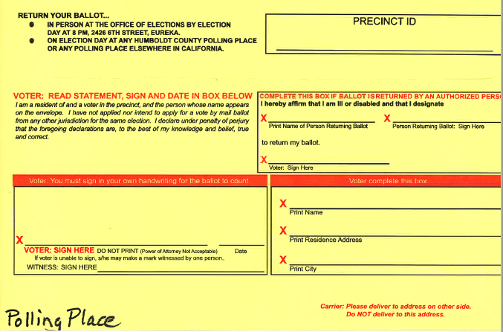
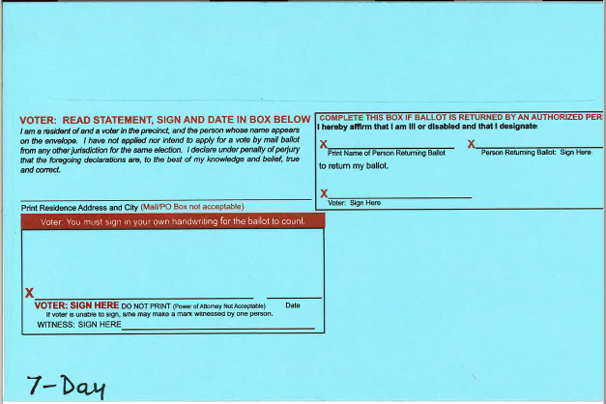
School of Instruction
ballot returns
POLLS
7-DAY
VBM

Slide 25
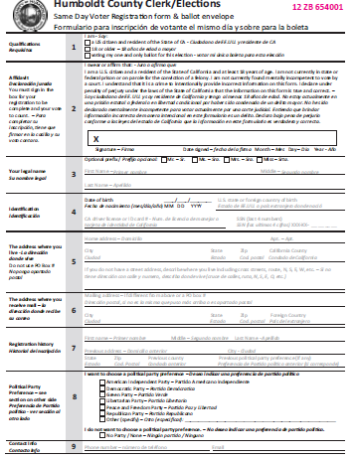
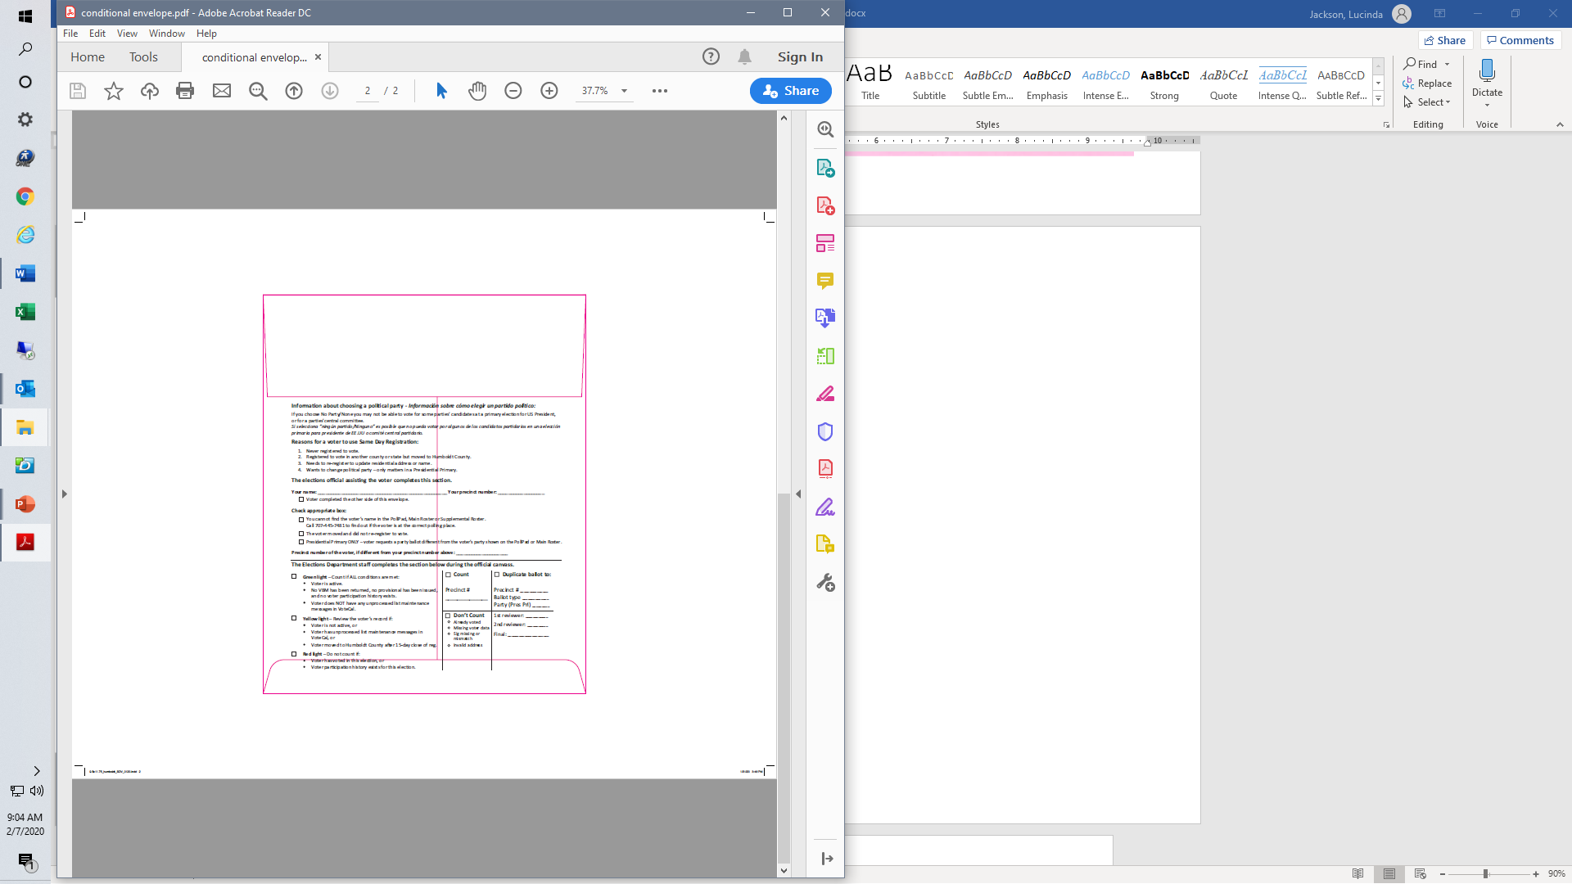
Common Reasons
Provisional voters
PROVISIONAL VOTERS WILL USE TOUCH WRITER TO MARK THEIR BALLOT
Wrong voter assistance center.
Cannot get to assigned voter assistance center before the polls close.
You are challenging the voter.
PROVISIONAL BALLOTS WILL NOT GO THROUGH THE SCAN

Slide 26
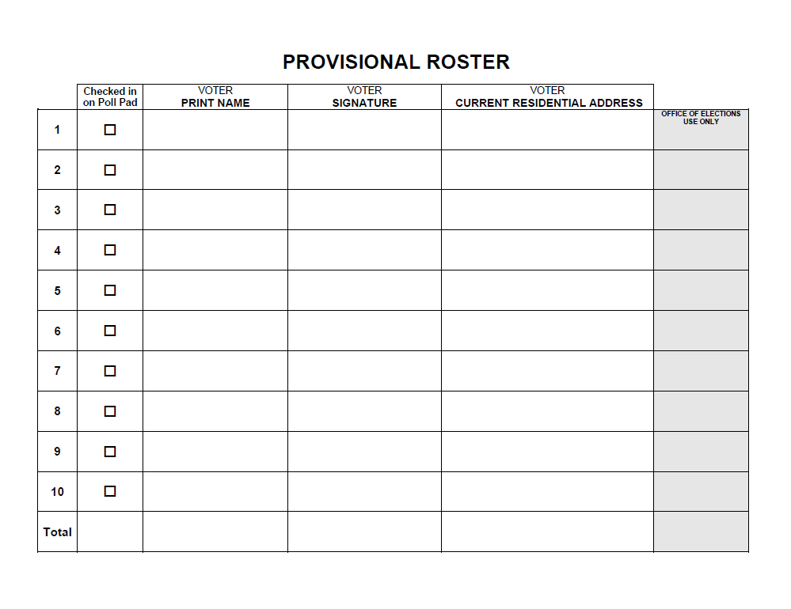
School of Instruction
Provisional roster
Provisional voters will sign a combined roster.

Slide 27
School of Instruction
Hava voter identification
When Identification is Required
Acceptable Identification
If the voter does not have acceptable identification:
  Do not turn the voter away.
  Issue the voter a provisional ballot.
NO IDENTIFICATION IS REQUIRED
UNLESS DESIGNATED ON THE MAIN ROSTER OR POLL PAD

Slide 28
School of Instruction
Hava Acceptable identification
Non-Government
Government
Photo ID
Passport
Employee ID
Military ID
Health Club ID
Insurance ID
Current Utility Bill
Drug Prescription
Tribal Membership Card
Official Election Mail
Government Check
Lease or Rental Agreement
Tuition Statement
Public Transportation Card
Senior Citizen Card
Disabled Discount Card
Property Tax Statement
Vehicle Registration

Slide 29
“
A voter is sometimes identified as being “Inactive.” Typically, this is because the Office of Elections received back undeliverable mail for the voter. Voter information needs to be verified before they can proceed to vote.
”
INACTIVE VOTERS

Slide 30
School of Instruction
Inactive voters
When a voter has:
Same Address
  Process voter as a precinct voter.
Different Address
  Process voter as a provisional voter.
REVIEW THE MANUAL CAREFULLY. BE READY TO PROCESS INACTIVE VOTERS.

Slide 31
“
A voter may have changed their name and not reregistered. If only the name has changed, the voter can vote a precinct ballot. If any other information changed, the voter must reregister and vote a provisional ballot.
”
NAME CHANGE
VOTERS

Slide 32
School of Instruction
NAME CHANGE voters
When a voter changed their name and didn’t reregister, the voter signs the roster twice:
First signature: previous name.
Second signature: current name.
REVIEW THE MANUAL CAREFULLY. BE READY TO PROCESS NAME CHANGE VOTERS.

Slide 33
Challenge Reasons
CHALLENGED VOTERS
Not person registered.
Not resident of precinct.
Not a US citizen.
Already voted this election.
On parole for conviction of a felony.
Intimidating or coercing voters.
Tampering with a voting system.
Disrupting the operation of a voter assistance center.

Slide 34
Section 5
COVID Protection and Guidelines

Slide 35
School of Instruction
COVID PROTECTION AND GUIDELINES
Personal Protective Equipment (PPE)
Hand Hygiene
Masks and Face Coverings
Disinfectant Wipes
Face Shields
Plexiglass Dividers
Gloves
Election Worker Proper Use of PPE Video
PPE WILL BE PROVIDED FOR ELECTION WORKER AND VOTER USE

Slide 36
School of Instruction
PHYSICAL DISTANCING
Physical (Social)Distancing
Maintain 6-feet of distance between yourself and others.
Configure voting area to allow for at least 6-feet of distance between:
  Booths.
  Voting stations.
  Paths of travel.
Voter Check-in Queue
Set-up outside of voter assistance center.
Only allow 5-6 voters in the voting area at a time.
Thoroughly clean after each group of voters is processed.

Slide 37
School of Instruction
CONFIGURING VOTING AREA
Create a natural flow directing voters along a one-way path of travel.

Slide 38
School of Instruction
ELECTION WORKER SCREENING
Complete screening before:
Attending in-person training.
Arriving to your assigned voter assistance center.
Screening includes:
Take temperature.
Symptom check*.
Apply hand hygiene.
*Symptom check: Read page 40 for detailed list of symptoms to screen for.
IF YOU HAVE COLD, FLU, OR COVID SYMTPOMS OR A TEMPERATURE OF 100.4 OR GREATER STAY HOME AND CALL A PERSONAL HEALTHCARE PROVIDER

Slide 39
School of Instruction
CLEANING GUIDELINES
When to Clean:
Before the polls open.
After each group of voters are processed.
After polls close.
What to Clean:
Doors and hardware.
Tables and surfaces.
Voting equipment and Poll Pad.
REVIEW THE MANUAL CAREFULLY FOR VOTING EQUIPMENT CLEANING INSTRUCTIONS.
DO NOT USE DISINFECTANT WIPES ON VOTING EQUIPMENT.

Slide 40
School of Instruction
WORKSITE ACTION PLAN
Worksite action plan provides:
Contact information.
Procedures for reporting COVID-related instances.
Safety and cleaning information.
Template for worksite evaluation.
Managers are responsible for completing a worksite evaluation form twice each day:
1st evaluation: 10 – 11 am.
2nd evaluation: 2 – 3 pm.

Slide 41
School of Instruction
DISCUSSION SCENARIO
COVID PPE SCENARIO
A team member refuses to wear their facial covering or repeatedly removes it when within 6-feet of other team members or voters.
What do you do?

Slide 42
School of Instruction
COVID-RELATED SIGNAGE
Exterior
Interior
COVID poster at front entrance.
Free-standing “Line starts here” sign.
Blue masking tape to mark 6-foot standing markers.
Blue masking tape to mark 6-foot arrow markers directing voters along the one-way path of travel.
EXTERIOR AND INTERIOR SIGNAGE MUST BE SET-UP BEFORE THE POLLS OPEN.

Slide 43
School of Instruction
PROCESSING VOTERS
Maintain a 6-foot distance from voters whenever possible.
Use PPE provided by the Office of Elections for your protection.
Curbside Voting Safety Considerations
Wear gloves.
Bring hand-sanitizer.
Wear a mask or face covering.
Ballot Handling Safety Considerations
Use disposable gloves when handling ballots and ballot envelopes.
REVIEW THE MANUAL CAREFULLY FOR COVID SAFETY CONSIDERATIONS WHEN PROCESSING VOTERS

Slide 44
School of Instruction
VOTERS WITHOUT FACE COVERINGS
If a voter arrives without a face covering offer the voter a temporary mask.
A leadership team member will be responsible for processing voters without a mask.
Escort to the table designated for unmasked voters.
Process the voter as a curbside voter.
REVIEW THE MANUAL CAREFULLY FOR PROCESSING VOTERS WITHOUT A MASK
VOTERS WITHOUT FACE COVERINGS SHOULD NEVER BE DENIED THE RIGHT TO VOTE

Slide 45
School of Instruction
DISCUSSION SCENARIO
COVID PPE SCENARIO
A voter refuses to wear their facial covering and escalates when you try to move them to the unmasked voter area.
What do you do?

Slide 46
School of Instruction
OBSERVERS AND WATCHERS WITHOUT FACE COVERINGS
If an observer or watcher arrives without a face covering offer the them a temporary mask.
If an observer or watcher refuses to wear a facial covering, contact the Office of Elections.
If the situation escalates contact law enforcement, then the Office of Elections.
IF SOMEONE FEELS UNSAFE OR THREATENED, CALL 9-1-1 THEN THE OFFICE OF ELECTIONS IMMEDIATELY

Slide 47
School of Instruction
CONFLICT DE-ESCALATION
Face coverings may be a point of conflict.
Rise above disgruntlement or anger using de-escalation measures:
Speak in a calm and normal volume.
Be respectful.
Resist the urge to engage in the conflict or argue.
Sheriff Office’s De-escalation Recommendations Video
REVIEW THE MANUAL CAREFULLY FOR DE-ESCALATION TECHNIQUES

Slide 48
Section 6
Election Worker Conduct

Slide 49
School of Instruction
ELECTION WORKER CONDUCT
Election workers are the public face of elections.
Create a politically neutral zone. Do not:
Wear political clothing or accessories.
Discuss political issues.
Play political social media, radio, or television programming.
IF TEAM MEMBERS ARE ENGAGING IN POLITICAL ACTIVITIES OR DISCUSSIONS, CONTACT THE OFFICE OF ELECTIONS IMMEDIATELY.

Slide 50
School of Instruction
ELECTION WORKER CONDUCT
Election Worker Reminders
DO | DO NOT
Wear politically neutral clothing Keep conversations with voters politically neutral Keep conversations with team members politically neutral Report any violations of this policy to the Office of Elections | Wear political clothing or accessories Discuss political issues Watch political social media or television programming Listen to social media or radio political programming

Slide 51
Section 7
Emergency Response

Slide 52
School of Instruction
INACCESSIBLE VOTER ASSISTANCE CENTERS
Emergencies that can cause a voter assistance center to be inaccessible:
  Non-operational due to fire.
  Non-operational due to earthquake.
  Planned and unplanned power outages.
  Essential services during government shutdown.
  Medical or life-threatening emergencies.
  Inaccessible election night drop-off locations.
Safety First
Document, Document, Document
REVIEW THE MANUAL CAREFULLY ABOUT HOW TO REPSPOND TO EMERGENCY SITUATIONS

Slide 53
School of Instruction
VOTER INTIMIDATION
Voter intimidation is illegal and is a serious offense.
Examples of Voter Intimidation
Blocking access to voting.
Threatening criminal action against voters.
Challenging voters’ right to vote.
Presenting false information to voters.
Assault, battery, threats of violence, brandishing of weapons
Safety First
Document, Document, Document
IF YOU OBSERVE VOTER INTIMIDATION, CONTACT LAW ENFORCEMENT AND OFFICE OF ELECTIONS

Slide 54
School of Instruction
DISCUSSION SCENARIO
VOTER INTIMIDATION SCENARIO
A voter is wearing a “blue wave” t-shirt or a “Make America Great Again” baseball cap.
What do you do?

Slide 55
Section 8
Conduct at the Polls

Slide 56
School of Instruction
OBSERVERS AND WATCHERS
Voter assistance centers will be visited by observers and watchers:
Observers typically:
  Provide identification.
  Provide written documentation of organization.
  Present to evaluate elections processes for best practices.
Watchers typically are:
  General members of the public.
  Not associated with organization.

Slide 57
School of Instruction
OBSERVERS AND WATCHERS
Create an assigned observer/watcher area.
Only 2 observers/watchers can be in the voting area at a time.
Observers/watchers must follow state and county guidelines:
Wear a facial covering.
Maintain 6-feet of physical distance from others.
IF AN OBSERVER REFUSES TO FOLLOW STATE AND COUNTY GUIDELINES, CONTACT THE OFFICE OF ELECTIONS IMMEDIATELY

Slide 58
School of Instruction
OBSERVERS AND WATCHERS
CAN
CANNOT
Observe voter assistance center activities.
  Procedures.
  Rosters.
  Setup.
  Closing.
Interfere, intimidate, or impede voter assistance center activities.
  Be in the voting area.
  Circulate a petition.
  Discuss measures or candidates on ballot.
  Touch voting materials.
  Take photos or videos.
REVIEW THE MANUAL CAREFULLY ABOUT OBSERVER AND WATCHER RIGHTS AND LIMITATIONS

Slide 59
School of Instruction
DISCUSSION SCENARIO
OBSERVER WATCHER SCENARIO
An observer refuses to leave the observer sitting area after 15 minutes and several observers/watchers are outside waiting.
What do you do?

Slide 60
the visible display or audible dissemination of information that advocates for or against any candidate or measure on the ballot within 100 feet…from the room or rooms in which voters are signing the roster and casting ballots.
“
”
ELECTIONEERING

Slide 61
School of Instruction
Electioneering
Candidate name.
Candidate logo.
Ballot measure number.
Ballot measure title.
Ballot measure logo.
Buttons, hats, shirts, etc.
Audible information about a candidate or measure.
Remove, reverse, or cover up clothing.
Turn off audible device.
Party clothing.
Party accessories.
Candidate slogans.
PROHIBITED
SOLUTIONS
PERMITTED
REPORT ELECTIONEERING TO THE OFFICE OF ELECTIONS IMMEDIATELY

Slide 62
School of Instruction
Ballot selfies and electronic devices
Voters may take a photograph of their ballot and share it on social media.
  Ballot selfie.
Voters cannot:
  Share unauthorized information about how a person voted.
  Solicit or receive consideration for or against a candidate or measure.
  Interfere or impede voter assistance center activities.
  Compromise the privacy of other voters.

Slide 63
School of Instruction
Cameras and video equipment
“
The Secretary of State’s office has historically taken the position that the use of cameras and video equipment at polling places is prohibited, except in limited circumstances.
”
Limited Cameras and Video Authorization
Exit Polling Must be 25 Feet Away
IF YOU ARE APPROACHED ABOUT HAVING CAMERAS OR FILMING IN THE VOTER ASSISTANCE CENTER, CONTACT THE OFFICE OF ELECTIONS IMMEDIATELY
CAMERAS & VOTING EQUIPMENT

Slide 64
School of Instruction
CONFLICT DE-ESCALATION
General elections are a point of conflict.
Remember to rise above disgruntlement or anger using de-escalation measures:
Speak in a calm and normal volume.
Be respectful.
Resist the urge to engage in the conflict or argue.
REVIEW THE MANUAL CAREFULLY FOR DE-ESCALATION TECHNIQUES

Slide 65
Section 9
Election Worker Basics

Slide 66
School of Instruction
ELECTION WORKER basics
Positions
High School Students as Clerks
Jobs and Voting Stations
Effective Teams

Slide 67
School of Instruction
positions
Manager
Leads team.
Coordinates with Elections and facility.
Assistant Manager
Under direction of manager, guides team.
Backup manager.
Voting Equipment Technician
Maintains smooth function of equipment.
Leads team in set-up and breakdown.
Clerk
Rovers
Team member.
Ballot Transporters
Delivers supplies to assigned voter assistance centers.
Picks up ballots from voter assistance centers.
Performs team assignments.
Picks up ballots from ballot drop boxes.

Slide 68
School of Instruction
Jobs and Voting stations
Voter Check-in
Ballot Handling Table
Hanging Roster Maintenance
Voting Machine Maintenance
Vote by Mail Table
Provisional Ballot Table
Voters without Facial Coverings
Cleaning Voting Area
REVIEW THE MANUAL CAREFULLY TO BE PREPARED TO PERFORM JOBS

Slide 69
School of Instruction
Jobs and voting stations
Voter
Check-in
Greet voter.
Check-in voter on Poll Pad and roster.
Ballot Handling
Greet voter.
Provide voter with voting materials.

Slide 70
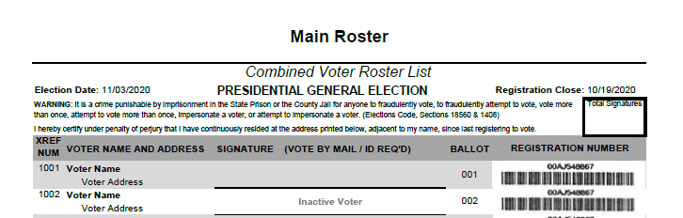
School of Instruction
Jobs and voting stations
Hanging
Roster
Update hanging roster or print Poll Pad list.
Post hanging roster or Poll Pad list outside.
Bring hanging roster in when polls close.

Slide 71
School of Instruction
Jobs and voting stations
Voting
Machines
Greet voter.
Assist voter cast ballot.
Return ballot materials to ballot handling table.
DO
DO NOT
View ballot.
Remove ballot from secrecy sleeve.
Feed ballot.
“I Voted” sticker.
Return materials.

Slide 72
School of Instruction
Jobs and voting stations
Vote by Mail Table
Greet voter.
Voter deposits ballot in sealed vote by mail container.
Provisional Table
Greet voter.
Guide voter to complete their provisional envelope and casting their ballot.

Slide 73
School of Instruction
Jobs and voting stations
Voters without Coverings
Greet voter.
Process voter as a curbside voter.
Cleaning
Clean before polls open and after polls close.
Clean after each group of voters is processed.

Slide 74
School of Instruction
Effective precinct board teams
Communication
Training
Assignments

Slide 75
Section 10
Voting Equipment and Security

Slide 76
School of Instruction
Voting equipment
Poll Pad
Ballot On-Demand
Scan and Ballot Box
Touch Writer and Printer
VOTING EQUIPMENT MANUALS AVAILABLE ONLINE
https://humboldtgov.org/2776/Election-Workers

Slide 77
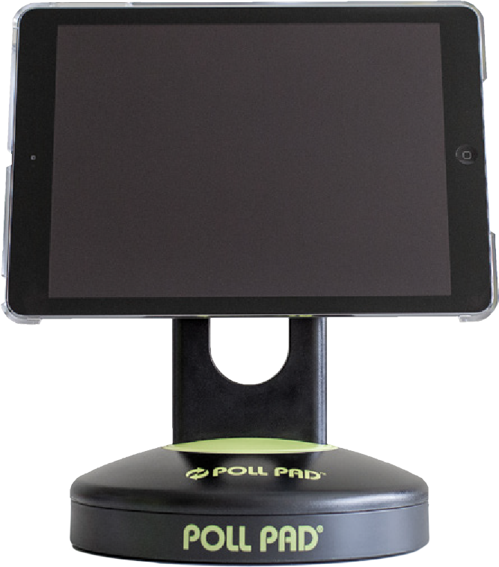
Poll Pad
Voting equipment
Voter check-in.
Voter look-up.
Determine status.
Look up voter assistance center.
VOTERS DO NOT SIGN THE POLL PAD

Slide 78
Scan
Voting equipment
Digitally scans ballots.
Deposits ballots into the ballot box.
Feeding ballots through Scan.
Ballot rejection:
  Overvote
  Undervote
2-Hour Battery backup for power outage.

Slide 79
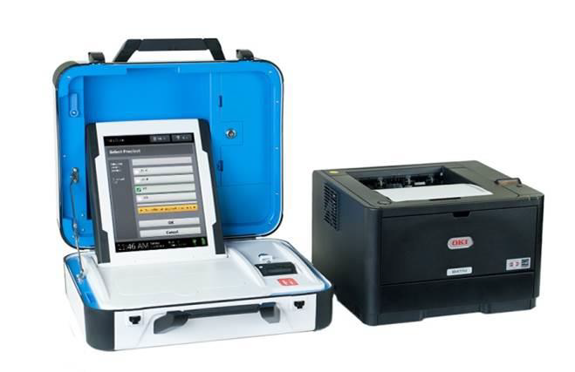
Ballot On-Demand
Voting equipment
Prints precinct ballots.
Backup if run out of pre-printed precinct ballots.
2-Hour Battery backup for power outage.

Slide 80
Touch Writer
VOTING EQUIPMENT
Accessible ballot marking device.
Verity Access offers additional input options.
2-Hour Battery backup for power outage.
UPS Battery backup for power outage.

Slide 81
keeping complete control of all voting equipment from the time it has been set for an election until it has been returned to the elections office and had its votes recorded.
“
”
CHAIN OF CUSTODY

Slide 82
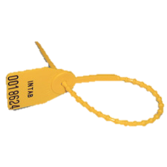
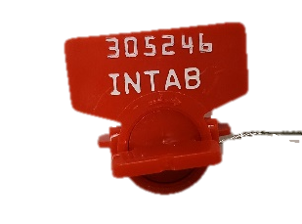
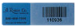
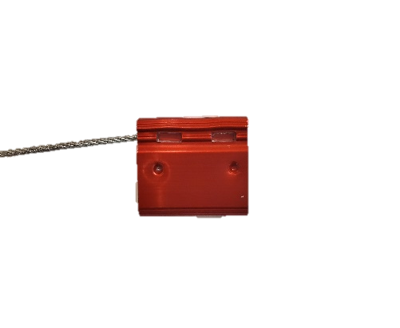
School of Instruction
Security seals
DO NOT REMOVE RED SEALS
Blue Supply Box
Voting Equipment Cases
Black Transport Bag
Emergencies
Printer Paper Drawer
Voting Equipment Memory Cards
Voting Equipment Tablets
Yellow Beaded
Tape
Red Wire
Uline

Slide 83
School of Instruction
SECURITY SEALS AND LOGS
Record Seal Numbers on Security Log
  Blue Supply Box
  Poll Pad
  Voting Equipment
Securing Voting Equipment and Supplies
  Blue supply box.
  Voting equipment.
  Setting up voter assistance center.
  Early voting and Election Day opening.
  Early voting and Election Night closing.
  Early voting ballot return.
  Election Night voting equipment and ballot return.

Slide 84
School of Instruction
SECURING VOTING EQUIPMENT AND ELECTION SUPPLIES
Securing Voting Equipment and Supplies
  Voting equipment.
  Blue supply box.
  Setting up voter assistance center.
  Election Morning setup.
  Election Night setup.
  Election Night equipment and black transport bag return.
TWO PEOPLE MUST ACCOMPANY VOTING EQUIPMENT AND TRANSPORT BAG

Slide 85
Section 11
Voter Assistance Center Layout

Slide 86
School of Instruction
VOTER ASSISTANCE CENTER LAYOUT
Physical (Social) Distancing
Maintain 6-feet of distance between yourself and others.
Configure voting area to allow for at least 6-feet of distance between:
  Booths.
  Voting stations.
  Paths of travel.
Signage
Place blue masking tape on the floor every 6-feet in the shape of arrows to guide voters along the one-way voting route.
6 feet

Slide 87
School of Instruction
CONFIGURING VOTING AREA
Remember:
Create a natural flow directing voters along a one-way path of travel.
Set-up your voter assistance center to match the ADA Guide graphic

Slide 88
Section 12
Voting Area Set-up Procedures

Slide 89
School of Instruction
VOTING AREA SET-UP PROCEDURES
Inventory blue supply box.
Set-up voting booths.
Set-up ballot box.
Set-up voter stations.
Post inside signs.
Set-up ADA mitigation inside the voting area.
Set-up observer seating area.

Slide 90
School of Instruction
VOTING AREA SET-UP PROCEDURES
Team Strategy
  Review binder.
  Review assignments and voting stations.
  Discuss break schedule.
MAINTAIN SECURITY OF BLUE SUPPLY BOX
DO NOT BRING VOTING EQUIPMENT INTO FACILITY
DO NOT BREAK BALLOT CONTAINER SEALS
Voting Set-up Support
  Lucinda will be on-call to troubleshoot set-up issues.

Slide 91
Section 13
Early Voting Opening Procedures

Slide 92
School of Instruction
Early voting opening procedures
Record Seal Numbers on Security Log
  Blue Supply Box
  Poll Pad
  Voting Equipment
Set-up Voting Equipment
  Requires two people.
  Run zero tapes.
Inventory Pre-Printed Ballots and Ballot Stock
Set-up Voting Stations
Convert Blue Supply Box to Ballot Box
Post Outside Signs
ADA Mitigation Outside

Slide 93
School of Instruction
Early voting opening procedures
Morning Paperwork
  Paysheet.
  Sign voting equipment zero tapes.
  Name tags.
Voting Set-up Support
  Office of Elections main line.
  Emergency hotline.
  Lucinda Jackson.
POLLS OPEN AT 8 AM

Slide 94
The polls are open!
8:00 AM
Manager announces:
“
”

Slide 95
Section 14
Early Voting Night Closing Procedures

Slide 96
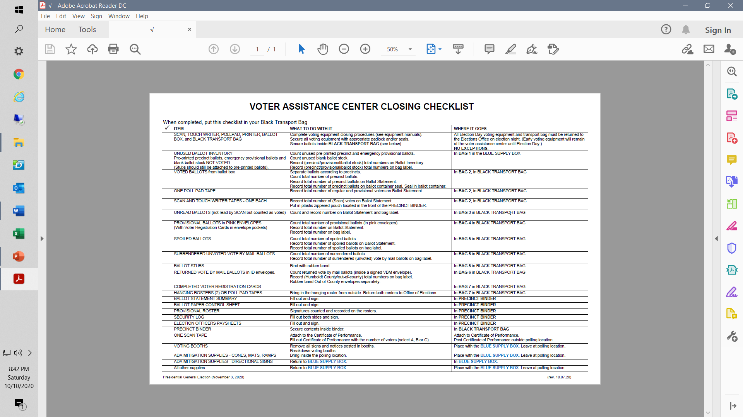
School of Instruction
EARLY VOTING NIGHT CLOSING PROCEDURES
Getting Organized
  Create a game plan before the polls close to assign closing tasks.
Supply Closing Checklist
  What to do.
  Where it goes.

Slide 97
The polls are closed!
4:00 PM
Manager announces:
“
”
ALLOW ANYONE IN LINE AT 4 PM TO VOTE

Slide 98
School of Instruction
Equipment and supplies
Used ballots:
  Precinct.
  Provisional.
  Spoiled.
  Surrendered.
Voted Vote by Mail Ballots
Voting equipment.
Printers.
Ballot boxes.
Unused ballots.
Blank ballot stock.
Roster binders.
Team binder.
Supply bags.
Caddy
Blue Supply Box
Ballot Transporter Pick-up
SECURE AND LOCK CADDY AND BLUE SUPPLY BOX
SECURE AND SEAL VOTED BALLOTS IN TRANSPORT BAG

Slide 99
School of Instruction
CLOSING ACTIVITIES
Inventory
  Pre-Printed Ballots and Ballot Stock
  Precinct Ballots Issued
  Precinct Ballots in Ballot Box
  Other Used Ballots
Suspend Polls and Breakdown Voting Equipment
Breakdown Voter Assistance Center
VOTING EQUIPMENT MANUALS AVAILABLE ONLINE
https://humboldtgov.org/2776/Election-Workers

Slide 100
School of Instruction
Ballot statement SUMMARY
Ballots Recorded on the Ballot Statement Summary
Information Needed
Preparation – Bags 1-7
  Unused ballots.
  Voted precinct ballots.
  Unread precinct ballots.
  Voted provisional ballots.
  Spoiled ballots.
  Voted vote by mail ballots returned.
  Voter registration cards and hanging rosters.
When the Ballot Statement Summary Doesn’t Balance

Slide 101
School of Instruction
Ballot statement summary
Completing the Ballot Statement Summary
  Follow step-by-step instructions.
  Certification of number of voters.
If after 1 hour of trying to balance you have not succeeded:
  Stop.
  Pack up supplies.
  Clean up the voting assistance center.
  Prepare black transport bag for ballot transporter pick-up.
DO NOT RECORD VOTE BY MAIL BALLOTS ON BALLOT STATEMENT SUMMARY

Slide 102
School of Instruction
Closing the polls
Record Seal Numbers on Security Log
  Blue supply box.
  Poll Pad.
  Voting equipment.
Team Paperwork
  Security log.
  Ballot paper control sheet.
  Ballot statement summary.

Slide 103
School of Instruction
Ballot transporter ballot pick-up
Ballot transport teams will pick-up voted ballots from voter assistance centers.
  Inventory all used ballots.
  Place used ballots in black transport bag.
  Seal black transport bag.
  Manager completes voted ballot pick-up official receipt.
BALLOT TRANSPORT TEAMS WILL PICK-UP BALLOTS BETWEEN 4:30 – 5:30 PM

Slide 104
School of Instruction
CLOSING ACTIVITIES
Bring outside postings and ADA mitigation supplies inside the voter assistance center.
Leave locked caddy and blue supply box at the voter assistance center for the next day of voting.
MAINTAIN SECURITY OF BLUE SUPPLY BOX
SECURE AND SEAL BALLOTS AND VOTING EQUIPMENT
Voting Closing Support
  Lucinda will be on-call to troubleshoot closing issues.

Slide 105
Section 15
Election Morning Opening Procedures

Slide 106
School of Instruction
Election morning opening procedures
Record Seal Numbers on Security Log
  Blue Supply Box
  Poll Pad
  Voting Equipment
Set-up Voting Equipment
  Requires two people.
  Run zero tapes.
Inventory Pre-Printed Ballots and Ballot Stock
Set-up Voting Stations
Convert Blue Supply Box to Ballot Box
Post Outside Signs
ADA Mitigation Outside

Slide 107
School of Instruction
ELECTION MORNING opening procedures
Morning Paperwork
  Paysheet.
  Sign voting equipment zero tapes.
  Name tags.
Election Morning Set-up Support
  Office of Elections main line.
  Emergency hotline.
  Lucinda Jackson.
POLLS OPEN AT 7 AM

Slide 108
The polls are open!
7:00 AM
Manager announces:
“
”

Slide 109
Section 16
Election Night Closing Procedures

Slide 110
School of Instruction
ELECTION NIGHT CLOSING PROCEDURES
Getting Organized
  Create a game plan before the polls close to assign closing tasks.
Supply Closing Checklist
  What to do.
  Where it goes.

Slide 111
The polls are closed!
8:00 PM
Manager announces:
“
”
ALLOW ANYONE IN LINE AT 8 PM TO VOTE

Slide 112
School of Instruction
CLOSING ACTIVITIES
Inventory
  Pre-Printed Ballots and Ballot Stock
  Precinct Ballots Issued
  Precinct Ballots in Ballot Box
  Other Used Ballots
Close Polls and Breakdown Voting Equipment
Breakdown Voter Assistance Center
VOTING EQUIPMENT MANUALS AVAILABLE ONLINE
https://humboldtgov.org/2776/Election-Workers

Slide 113
School of Instruction
Ballot statement SUMMARY
Ballots Recorded on the Ballot Statement Summary
Information Needed
Preparation: Bags 1-7
  Unused ballots.
  Voted precinct ballots.
  Unread precinct ballots.
  Voted provisional ballots.
  Spoiled ballots.
  Voted vote by mail ballots returned.
  Voter registration cards and hanging rosters.
When the Ballot Statement Summary Doesn’t Balance

Slide 114
School of Instruction
Ballot statement summary
Completing the Ballot Statement Summary
  Follow step-by-step instructions.
  Certification of number of voters.
If after 1 hour of trying to balance you have not succeeded:
  Stop.
  Pack up supplies.
  Clean up the voting assistance center.
  Prepare voting equipment and ballots for either delivery to drop-off location or ballot transporter pick-up.
DO NOT RECORD VOTE BY MAIL BALLOTS ON BALLOT STATEMENT SUMMARY

Slide 115
School of Instruction
Election night ballot return
Some teams will deliver voting equipment and ballots to a drop-off location.
Other teams will have voting equipment and ballots picked up by a ballot transporter team.
REVIEW ELECTION NIGHT BALLOT RETURN SECTION CAREFULLY FOR ELECTION NIGHT RETURN PROCEDURES
TWO TEAM MEMBERS MUST ACCOMPANY EQUIPMENT AND BLACK TRANSPORT BAG

Slide 116
School of Instruction
ELECTION NIGHT CLOSING PROCEDURES
Team Paperwork
  Ballot paper control sheet.
  Ballot statement summary.
  Security log.
MAINTAIN SECURITY OF BLUE SUPPLY BOX
SECURE AND SEAL BALLOTS AND VOTING EQUIPMENT
Voting Closing Support
  Lucinda will be on-call to troubleshoot closing issues.

Slide 117
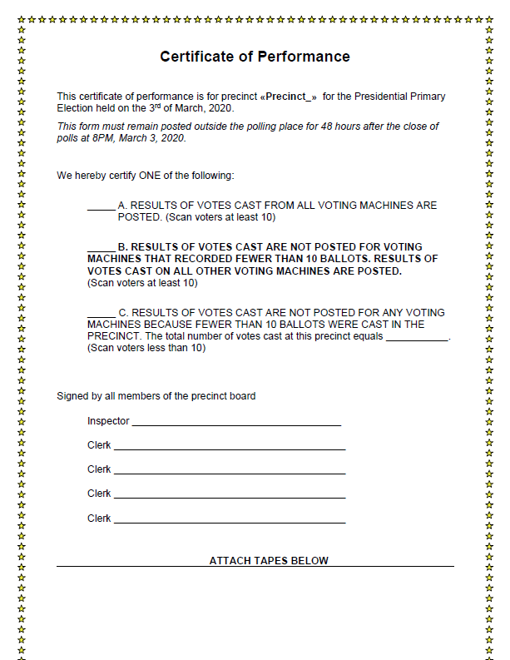
School of Instruction
CERTIFICATE OF PERFORMANCE
Complete and sign Certificate of Performance.

Slide 118
School of Instruction
BREAKDOWN VOTER ASSISTANCE CENTER
Outside
Inside
Gather mitigation supplies.
Bring in hanging roster and outside signs.
Gather mitigation supplies.
Take down inside and voting booth signs.
Clean up areas used.
  Voting area.
  Kitchen.
  Other areas.

Slide 119
School of Instruction
Equipment and supplies
Printers.
Ballot boxes.
Touch writers.
Unused ballots.
Blank ballot stock.
Voting booths.
Caddy.
Mitigation supplies.
Parking signs.
Scans.
Poll Pads.
Black transport bag.
Caddy
Blue Supply Box
Ballot Transporter Pick-up
SECURE AND LOCK CADDY AND BLUE SUPPLY BOX
SECURE AND SEAL VOTED BALLOTS IN TRANSPORT BAG

Slide 120
School of Instruction
Contact information
Humboldt County Office of Elections
2426 6th Street | Eureka, CA 95501
707-445-7481
https://humboldtgov.org/elections
Lucinda Jackson
707-616-4503 (call/text okay)
ljackson@co.humboldt.ca.us
California Secretary of State’s Voter Hotline
800-345-8683

